Slide 1

Discovering the Ideal Location for an Italian Cafe
Chris Au
May 2020

Slide 2
Summarizing the Requirements
Determining an ideal location for a small business is vital to its success
Owner wants to build an Italian themed café near the Sangenjaya in Tokyo
The goal is to create a place where clients can sit an enjoy an espresso or dessert after their lunch or dinner.
Owner has requested their café be placed close to other Italian themed venues while avoiding other cafés or coffee shops.

Slide 3

Data acquisition and cleaning
Majority of data can be obtained from the publicly available Foursquare API.
Pros
Lots of data available including Venues, Category and Location
Able to pull data from specific regions
Data is generally formatted well and complete
Cons
Public API has limitations to how much data can be gathered. Multiple calls are needed

Slide 4
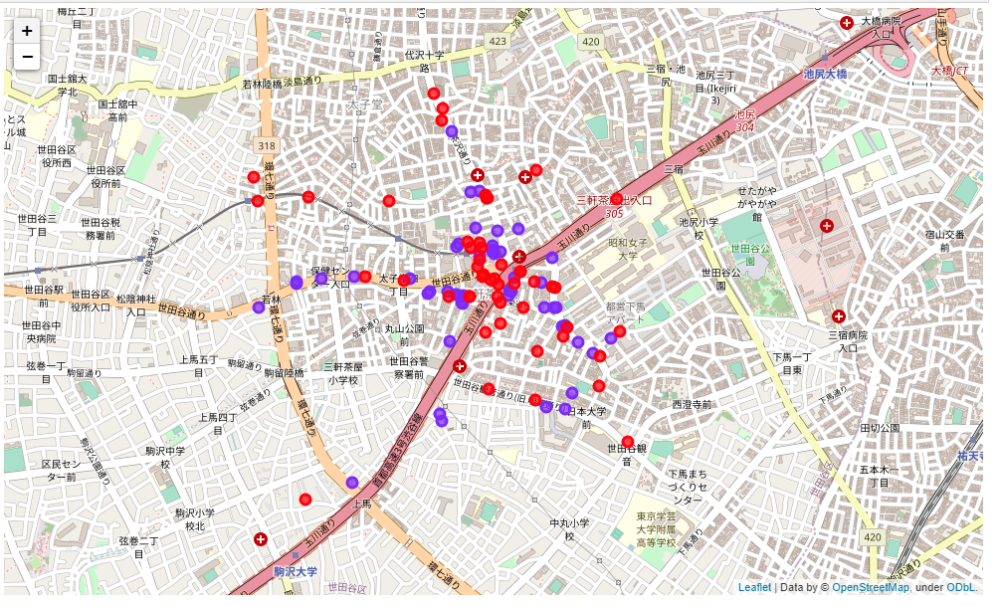
Reviewing Venues in Sangenjaya
Purple – Italian Restaurants
Red – Cafés

Slide 5
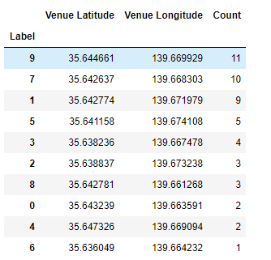
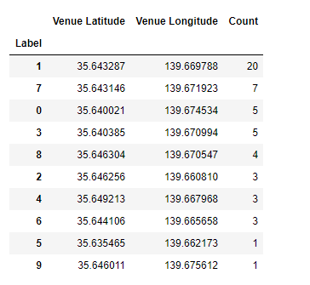
Grouping Data
Italian Venues
Café Venues

Slide 6
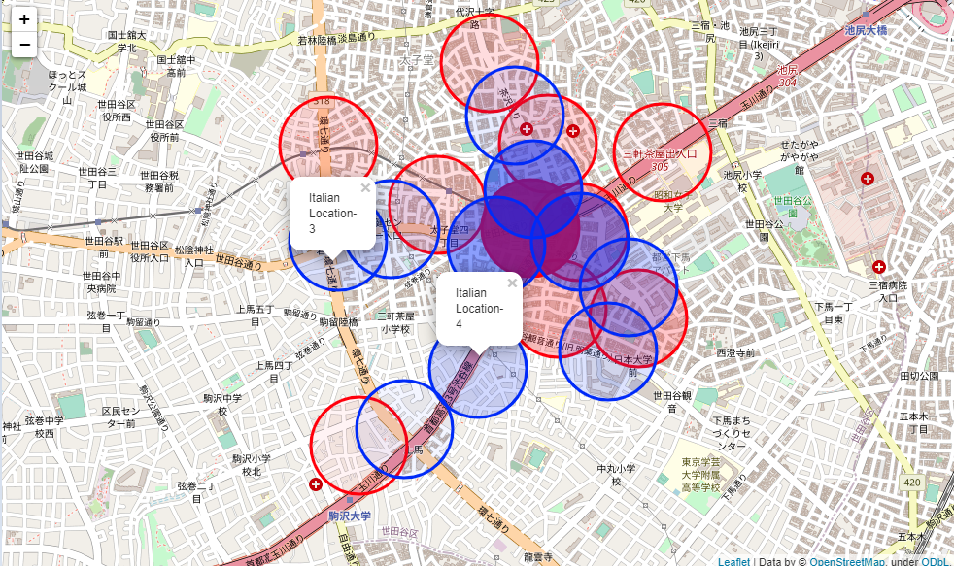
Grouping Data

Slide 7
Results and Analysis
Based on the grouping analysis Zones 3 and 4 are best suited based on the starting criteria.
Zone | Venue Category | Venue Name
3 | Italian Restaurant | Euro
3 | Italian Restaurant | Hamano
3 | Italian Restaurant | ナティーボ
3 | Italian Restaurant | オステリア ドゥエ
4 | Italian Restaurant | Three
4 | Italian Restaurant | Taverna Ichi

Slide 8

Conclusion
Based on the analysis Zone 3 is the best area to build the clients Italian themed Café. This zone has a moderately dense amount of Italian Restaurants at 4 with no cafés or coffee shops.

